Slide 1

Responsive Web Design

Slide 2

What is (RWD)
What RWD is
Fluid layouts
Media queries
Design strategies and patterns
Testing options

Slide 3
Introduction to RWD
RWD is a design and production approach that allows a web page to adapt to the screen it is viewed on.
The same HTML source is styled differently based on the width of the screen.
It ensures mobile users get the same content as other users, with a presentation that optimizes usability.
The term was coined by Ethan Marcotte in 2010 in his article “Responsive Web Design” for A List Apart.

Slide 4

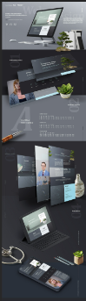
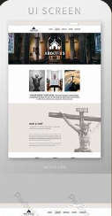
RWD – Examples:

Slide 5
The Components of RWD
Fluid layout / flexible grid Elements are sized so they squeeze and flow into the available browser space.
Flexible images Images and other embedded media scale to fit their containing elements.
CSS media queries
These are a way to test for browser features such as viewport width and deliver styles accordingly.

Slide 6
Setting the Viewport
Mobile browsers render pages on a canvas called the viewport and then shrink it to fit the screen (device width).
To make the viewport the same size as the device width:
<meta name="viewport" content="width=device-width, initial-scale="1">

Slide 7
Example 1.html
<!DOCTYPE html>
<html lang="en">
<head>
<title>A floated layout using pixels</title>
<meta charset="utf-8" />
<meta http-equiv="X-UA-Compatible" content="IE=edge">
<meta name="viewport" content="width=device-width, initial-scale=1">
<link rel="stylesheet" href="/style.css">
</head>
<body>
<article role="main">
<div class="content">
<h1>
A layout using floats
</h1>
<p>
The main content area is 700px wide.
</p>
<p>
Veggies es bonus vobis, proinde vos postulo essum magis kohlrabi welsh onion daikon amaranth tatsoi tomatillo melon azuki bean garlic.
</p>
<p>
Gumbo beet greens corn soko endive gumbo gourd. Parsley shallot courgette tatsoi pea sprouts fava bean collard greens dandelion okra wakame tomato. Dandelion cucumber earthnut pea peanut soko zucchini.
</p>
</div>
<aside>
<p>
The sidebar is 200px wide.
</p>
</aside>
</article>
</body>
</html>

Slide 8
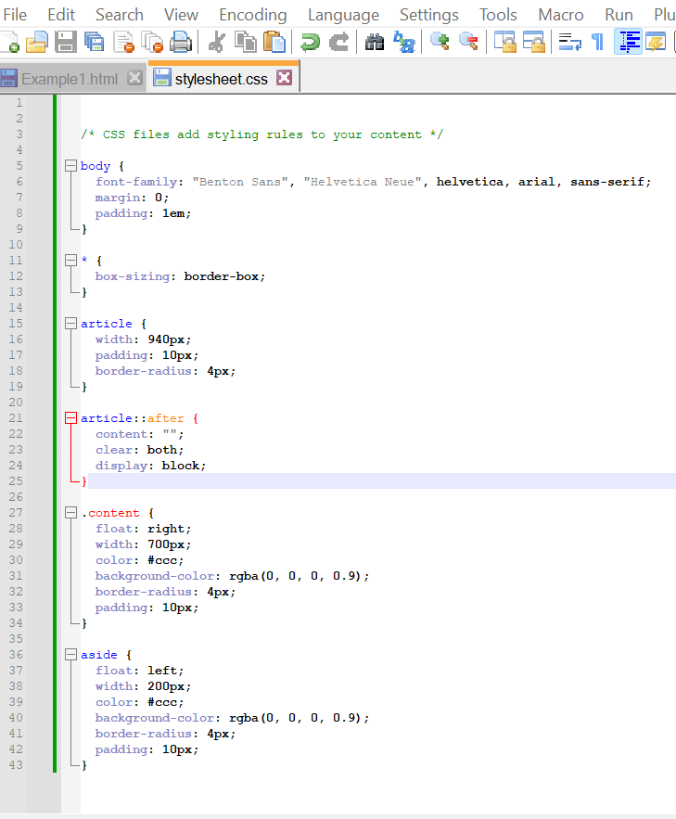
Example 1: - StyleSheet.CSS
/* CSS files add styling rules to your content */
body {
font-family: "Benton Sans", "Helvetica Neue", helvetica, arial, sans-serif;
margin: 0;
padding: 1em;
}
* {
box-sizing: border-box;
}
article {
width: 940px;
padding: 10px;
border-radius: 4px;
}
article::after {
content: "";
clear: both;
display: block;
}
.content {
float: right;
width: 700px;
color: #ccc;
background-color: rgba(0, 0, 0, 0.9);
border-radius: 4px;
padding: 10px;
}
aside {
float: left;
width: 200px;
color: #ccc;
background-color: rgba(0, 0, 0, 0.9);
border-radius: 4px;
padding: 10px;
}

Slide 9
Setting the Viewport
<meta name="viewport" content="width=device-width, initial-scale="1">
*turns a regular webpage into a responsive page Tells the browser to set the width of the viewport equal to the width of the device screen (width=device-width)
Why? To fit standard websites onto small screens, mobile browsers render the page on a canvas called the viewport and then shrink that viewport down to fit the width of the screen (device width).
Example: on iPhones, Mobile Safari sets the viewport width to 980 pixels, so a web page is rendered as though it were on a desktop browser window set to 980 pixels wide.
But that rendering gets shrunk down to 320 pixels wide (portrait orientation) viewport element is a re-set – telling the browser to set the width of the content to the width of the device itself, and to scale that content to 1 (100%) on load

Slide 10
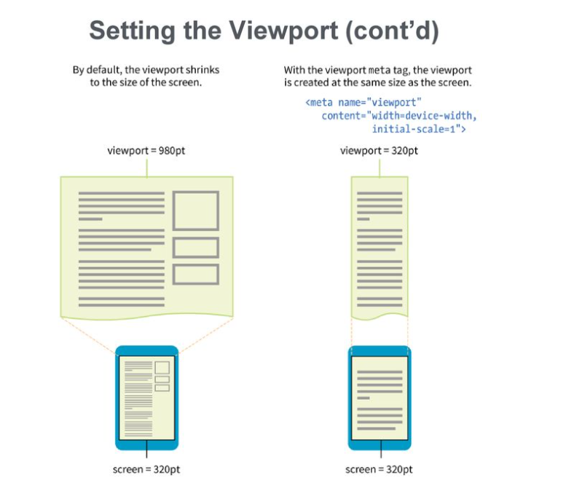
Setting the viewpoint
Designing For The Best Experience For All Users
Web pages can be viewed using many different devices: desktops, tablets, and phones. Your web page should look good, and be easy to use, regardless of the device.
Web pages should not leave out information to fit smaller devices, but rather adapt its content to fit any device.
It is called responsive web design when you use CSS and HTML to resize, hide, shrink, enlarge, or move the content to make it look good on any screen.

Slide 11
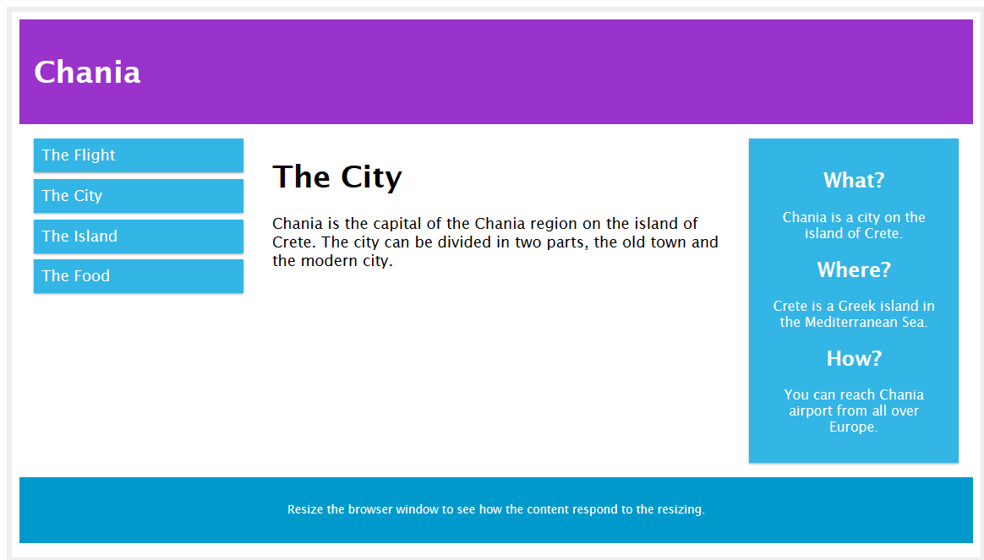
Setting the viewpoints

Slide 12
Let’s develop Second example2.html PART A
<!DOCTYPE html>
<html>
<head>
<meta name="viewport" content="width=device-width, initial-scale=1.0">
<style>
* {
box-sizing: border-box;
}
.row::after {
content: "";
clear: both;
display: table;
}
[class*="col-"] {
float: left;
padding: 15px;
}
html {
font-family: "Lucida Sans", sans-serif;
}
.header {
background-color: #9933cc;
color: #ffffff;
padding: 15px;
}

Slide 13
Let’s develop Second example2.html PART B
.menu ul {
list-style-type: none;
margin: 0;
padding: 0;
}
.menu li {
padding: 8px;
margin-bottom: 7px;
background-color: #33b5e5;
color: #ffffff;
box-shadow: 0 1px 3px rgba(0,0,0,0.12), 0 1px 2px rgba(0,0,0,0.24);
}
.menu li:hover {
background-color: #0099cc;
}
.aside {
background-color: #33b5e5;
padding: 15px;
color: #ffffff;
text-align: center;
font-size: 14px;
box-shadow: 0 1px 3px rgba(0,0,0,0.12), 0 1px 2px rgba(0,0,0,0.24);
}
.footer {
background-color: #0099cc;
color: #ffffff;
text-align: center;
font-size: 12px;
padding: 15px;
}
/* For mobile phones: */
[class*="col-"] {
width: 100%;
}

Slide 14
Let’s develop Second example2.html PART C
@media only screen and (min-width: 600px) {
/* For tablets: */
.col-s-1 {width: 8.33%;}
.col-s-2 {width: 16.66%;}
.col-s-3 {width: 25%;}
.col-s-4 {width: 33.33%;}
.col-s-5 {width: 41.66%;}
.col-s-6 {width: 50%;}
.col-s-7 {width: 58.33%;}
.col-s-8 {width: 66.66%;}
.col-s-9 {width: 75%;}
.col-s-10 {width: 83.33%;}
.col-s-11 {width: 91.66%;}
.col-s-12 {width: 100%;}
}
@media only screen and (min-width: 768px) {
/* For desktop: */
.col-1 {width: 8.33%;}
.col-2 {width: 16.66%;}
.col-3 {width: 25%;}
.col-4 {width: 33.33%;}
.col-5 {width: 41.66%;}
.col-6 {width: 50%;}
.col-7 {width: 58.33%;}
.col-8 {width: 66.66%;}
.col-9 {width: 75%;}
.col-10 {width: 83.33%;}
.col-11 {width: 91.66%;}
.col-12 {width: 100%;}
}
</style>

Slide 15
Let’s develop Second example2.html PART D
</head>
<body>
<div class="header">
<h1>Chania</h1>
</div>
<div class="row">
<div class="col-3 col-s-3 menu">
<ul>
<li>The Flight</li>
<li>The City</li>
<li>The Island</li>
<li>The Food</li>
</ul>
</div>
<div class="col-6 col-s-9">
<h1>The City</h1>
<p>Chania is the capital of the Chania region on the island of Crete. The city can be divided in two parts, the old town and the modern city.</p>
</div>

Slide 16
Let’s develop Second example2.html PART E
<div class="col-3 col-s-12">
<div class="aside">
<h2>What?</h2>
<p>Chania is a city on the island of Crete.</p>
<h2>Where?</h2>
<p>Crete is a Greek island in the Mediterranean Sea.</p>
<h2>How?</h2>
<p>You can reach Chania airport from all over Europe.</p>
</div>
</div>
</div>
<div class="footer">
<p>Resize the browser window to see how the content respond to the resizing.</p>
</div>
</body>
</html>

Slide 17

Fluid Layout
The rising popularity of smartphones and tablets has left web designers with quite a challenge to create online experiences that not only display in a standard browser window, but also on screens a fraction of the size.
Every successful website needs to be planned with mobile users in mind. There are now even web development frameworks that prioritize mobile interfaces.
Most online businesses can’t afford to lose mobile users with poor design and usability.

Slide 18
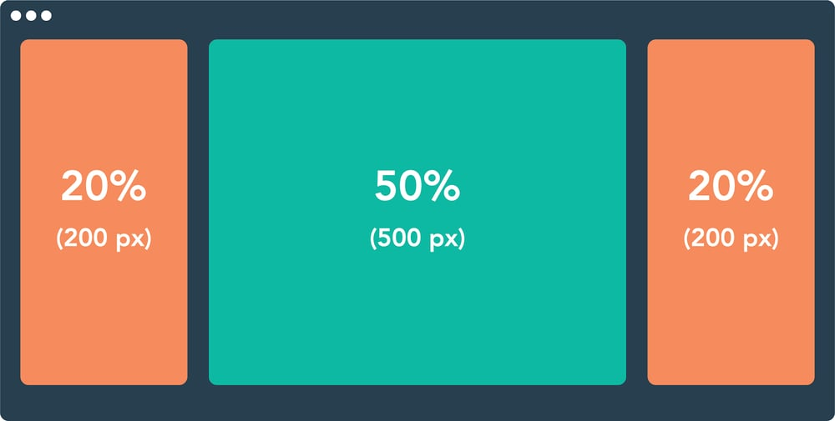
Fluid Layout
In fluid web design, the widths of page elements are set proportional to the width of the screen or browser window. A fluid website expands or contracts based on the width of the current viewport.
Fluid design helps make websites more usable across device types with varying screen dimensions.
Let’s imagine a website with three adjacent elements, one with a width set to 50% and two smaller elements with widths of 20% (for this demonstration, heights are unimportant). Let’s also put some margins between them.
When displayed in a browser window 1000 pixels wide, the website looks like this:

Slide 19
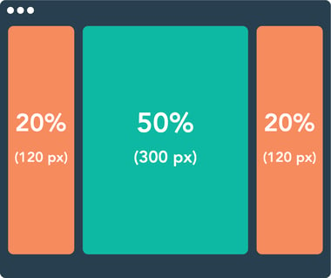
Fluid Layout
The width of each element in pixels is based on the 1000 px width of the viewport.
When we shrink the browser window to just 600 px, a fluid design scales these elements proportionally:
Fluid design ensures that a website always looks similar in layout regardless of the screen. A consistent layout benefits the user experience while ensuring usability for as many visitors as possible

Slide 20
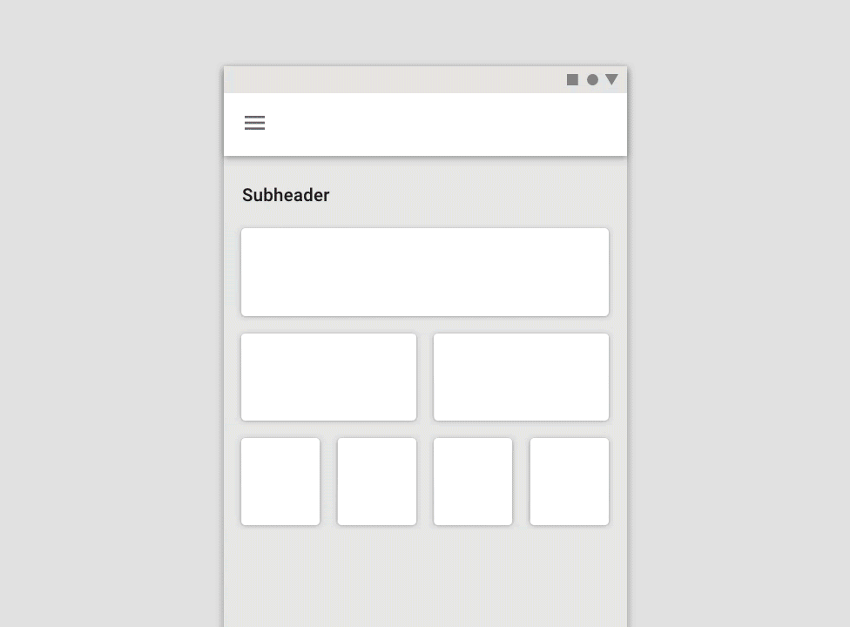
Fluid Layout - Fluid Grids in Web Design
Fluid grids are a common implementation of the fluid design approach. A fluid grid breaks down the width of the page into several equally sized and spaced columns. Page content is placed according to these columns.
When the viewport expands horizontally, each fluid column expands accordingly, as does the content within the columns:
Grids are a widespread layout for structuring page content in a digestible way, and applying fluid principles to grids is one way of making grids suitable for different screens.
However, fluid design isn’t the only approach — let’s compare it with three other common layout designs: fixed, adaptive, and responsive.

Slide 21
Fluid Layout – Fixed Design vs Fluid Design
Layouts that follow a fixed design do not conform to the viewport size. Unlike those in fluid designs and fluid grids, elements in a fixed layout are set to specific pixel widths, and these widths do not change by device or screen size.
Fixed design has lost favor among designers for its lack of flexibility and user-friendliness across devices. You’d be hard-pressed to find it applied to any professional website designers now usually for fluid, adaptive, and/or responsive sites instead. In most cases, it’s worth the effort rather than stick to fixed sizes.

Slide 22
Adaptive Design vs. Fluid Design
Fluid layouts help make websites more usable, but they lack the fine-tuned control of adaptive design. In the adaptive approach, designers create multiple separate website layouts for specific screen widths, the goal being to cater to multiple specific devices. So, a website might have a separate layout design for viewing on desktop, tablet, and smartphone.

Slide 23
Adaptive Design vs. Fluid Design
"Web designers achieve adaptive design with media queries, a feature of CSS that detects properties of the user’s device including screen dimensions. The media query reads the screen size, then selects the best-suited fixed layout from multiple fixed layout options"

Slide 24
Adaptive Design vs. Fluid Design
"Whereas fluid designs might look clunky on very large or very small screens, adaptive design lets us make more precise layouts for specific devices. You don’t need to worry about a poor user experience if you account for any device they use.
The tradeoff here, perhaps obviously, is that adaptive designs take much more time to make than fluid ones. Essentially, you’re creating multiple layouts rather than a single dynamic layout, so this approach may not be sustainable for individual website owners to pull off, especially as new devices enter the market."

Slide 25
"Responsive Design vs. Fluid Design"
"You might have heard the term “responsive” to describe any website that adjusts its layout for different devices. In this sense, both fluid and adaptive designs are technically “responsive.”
However, the terminology becomes a bit confusing here — “responsive” can also refer to a particular way of making these adjustments. Here I’ll be discussing responsive design in the latter sense."

Slide 26
"Responsive Design vs. Fluid Design"
"A responsive design layout is a single layout applied to a web page that reformats and resizes elements based on breakpoints. A breakpoint is a specific viewport width value (in pixels) that triggers a change in the website layout. Breakpoints are set in CSS with media queries.
Unlike fluid design, responsive websites use breakpoints to rearrange or eliminate elements on a page, instead of simply resizing them. Therefore, a responsive layout might appear quite different on a desktop versus a tablet versus or a smartphone."

Slide 27
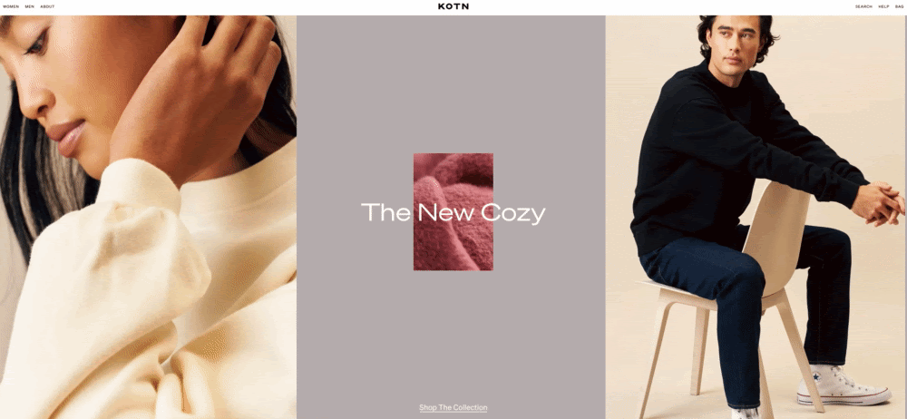
"Responsive Design vs. Fluid Design"

Slide 28
Responsive Design
"Responsive designs are the go-to for business websites with content-rich, highly interactive pages. Though they take more work to implement than purely fluid pages, a responsive design ensures that text, media, and interaction elements look great at any viewing width, especially when simply shrinking page elements width-wise doesn’t guarantee good usability or aesthetics."

Slide 29
When Should You Use Fluid Design?

Slide 30
"Fluid Design"
"Fluid design isn’t a one-size-fits-all solution, nor is responsive or adaptive design. These methods don’t have to be used in isolation, either principles from any of them can be combined to improve the mobile experience.“
"When considering a fluid design, you should think about:
Audience metrics: Tracking tools like Google Analytics can segment your traffic by desktop, tablet, and mobile. Use metrics to inform where you put your design resources.
Site content: If your site is relatively light on text, media, and interactive features, you can get away with a purely fluid design on some or all pages. Otherwise, it’s better to incorporate adaptive and responsive principles. Mapping your layout with wireframes is helpful in this phase.
Resources: Because of their relative simplicity, fluid designs generally take less time, money, and effort to incorporate from scratch. However, website builders with out-of-the-box responsive page templates have made complex responsive pages more attainable for those lacking the design chops."

Slide 31
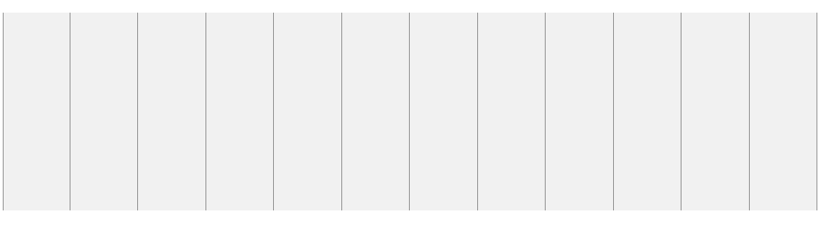
Grid-View
Many web pages are based on a grid-view, which means that the page is divided into columns:
Using a grid-view is very helpful when designing web pages. It makes it easier to place elements on the page.

Slide 32
Building a Responsive Grid-View
example4.html
<!DOCTYPE html>
<html>
<head>
<meta name="viewport" content="width=device-width, initial-scale=1.0">
<style>
* {
box-sizing: border-box;
}
.header {
border: 1px solid red;
padding: 15px;
}
.menu {
width: 25%;
float: left;
padding: 15px;
border: 1px solid red;
}
.main {
width: 75%;
float: left;
padding: 15px;
border: 1px solid red;
}
</style>
</head>
<body>
Let’s start building a responsive grid-view.
First ensure that all HTML elements have the box-sizing property set to border-box. This makes sure that the padding and border are included in the total width and height of the elements.
Add the following code in your CSS:
* { box-sizing: border-box; }
Read more about the box-sizing property in our CSS Box Sizing chapter.
The following example shows a simple responsive web page, with two columns:

Slide 33
Building a Responsive Grid-View
example4.html (Part B)
<div class="header">
<h1>Chania</h1>
</div>
<div class="menu">
<ul>
<li>The Flight</li>
<li>The City</li>
<li>The Island</li>
<li>The Food</li>
</ul>
</div>
<div class="main">
<h1>The City</h1>
<p>Chania is the capital of the Chania region on the island of Crete. The city can be divided in two parts, the old town and the modern city.</p>
<p>Resize the browser window to see how the content respond to the resizing.</p>
</div>
</body>
</html>

Slide 34
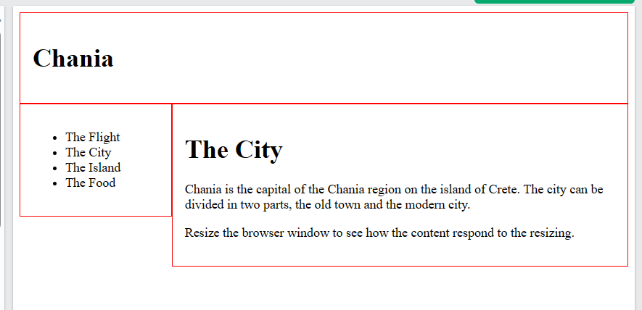

Slide 35
Building a Responsive Grid-View
<!DOCTYPE html>
<html>
<head>
<meta name="viewport" content="width=device-width, initial-scale=1.0">
<style>
* {
box-sizing: border-box;
}
.header {
border: 1px solid red;
padding: 15px;
}
.row::after {
content: "";
clear: both;
display: table;
}
[class*="col-"] {
float: left;
padding: 15px;
border: 1px solid red;
}
.col-1 {width: 8.33%;}
.col-2 {width: 16.66%;}
.col-3 {width: 25%;}
.col-4 {width: 33.33%;}
.col-5 {width: 41.66%;}
.col-6 {width: 50%;}
.col-7 {width: 58.33%;}
.col-8 {width: 66.66%;}
.col-9 {width: 75%;}
.col-10 {width: 83.33%;}
.col-11 {width: 91.66%;}
.col-12 {width: 100%;}
</style>
</head>
<body>
However, we want to use a responsive grid-view with 12 columns, to have more control over the web page.
First we must calculate the percentage for one column: 100% / 12 columns = 8.33%.
Then we make one class for each of the 12 columns, class="col-" and a number defining how many columns the section should span:
<div class="header">
<h1>Chania</h1>
</div>
<div class="row">
<div class="col-3">
<ul>
<li>The Flight</li>
<li>The City</li>
<li>The Island</li>
<li>The Food</li>
</ul>
</div>
<div class="col-9">
<h1>The City</h1>
<p>Chania is the capital of the Chania region on the island of Crete. The city can be divided in two parts, the old town and the modern city.</p>
<p>Resize the browser window to see how the content respond to the resizing.</p>
</div>
</div>
</body>
</html>

Slide 36
flexible images
img { max-width: 100%; }
flexible images: images scale down to fit the size of their container
When the layout gets smaller, the images will scale down to fit the width of the container they are in
When the container is larger than the image – the image does not scale larger; it stops at 100% of its original size

Slide 37
flexible images Example6.html
<!DOCTYPE html>
<html>
<head>
<meta name="viewport" content="width=device-width, initial-scale=1.0">
<style>
img {
width: 100%;
height: auto;
}
</style>
</head>
<body>
<img src=" https://m.media-amazon.com/images/I/71XVTfvvs1L._AC_SS65_.jpg " width="460" height="345">
<p>Resize the browser window to see how the image will scale.</p>
</body>
</html>
Using The width Property
If the width property is set to a percentage and the height property is set to "auto", the image will be responsive and scale up and down:

Slide 38
flexible images Example7.html
<!DOCTYPE html>
<html>
<head>
<meta name="viewport" content="width=device-width, initial-scale=1.0">
<style>
img {
max-width: 100%;
height: auto;
}
</style>
</head>
<body>
<img src="https://m.media-amazon.com/images/I/71XVTfvvs1L._AC_SS65_.jpg " width="460" height="345">
<p>Resize the browser window to see how the image will scale when the width is less than 460px.</p>
</body>
</html>
Using The max-width Property
If the max-width property is set to 100%, the image will scale down if it has to, but never scale up to be larger than its original size:

Slide 39
Background Images Example 8.html
<!DOCTYPE html>
<html>
<head>
<meta name="viewport" content="width=device-width, initial-scale=1.0">
<style>
div {
width: 100%;
height: 400px;
background-image: url('https://m.media-amazon.com/images/I/71XVTfvvs1L._AC_SS65_.jpg ');
background-repeat: no-repeat;
background-size: contain;
border: 1px solid red;
}
</style>
</head>
<body>
<p>Resize the browser window to see the effect.</p>
<div></div>
</body>
</html>
Background images can also respond to resizing and scaling.
Here we will show three different methods:
1. If the background-size property is set to "contain", the background image will scale, and try to fit the content area. However, the image will keep its aspect ratio (the proportional relationship between the image's width and height):

Slide 40
Background Images Example 9.html
<!DOCTYPE html>
<html>
<head>
<meta name="viewport" content="width=device-width, initial-scale=1.0">
<style>
div {
width: 100%;
height: 400px;
background-image: url(' https://m.media-amazon.com/images/I/71XVTfvvs1L._AC_SS65_.jpg ');
background-size: 100% 100%;
border: 1px solid red;
}
</style>
</head>
<body>
<p>Resize the browser window to see the effect.</p>
<div></div>
</body>
</html>
If the background-size property is set to "100% 100%", the background image will stretch to cover the entire content area:

Slide 41

Different Images for Different Devices
A large image can be perfect on a big computer screen, but useless on a small device. Why load a large image when you have to scale it down anyway? To reduce the load, or for any other reasons, you can use media queries to display different images on different devices.
Here is one large image and one smaller image that will be displayed on different devices:

Slide 42
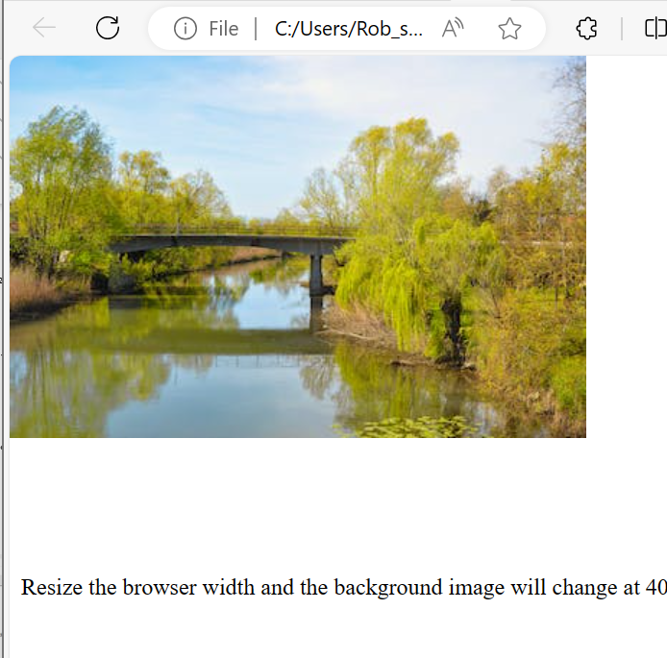
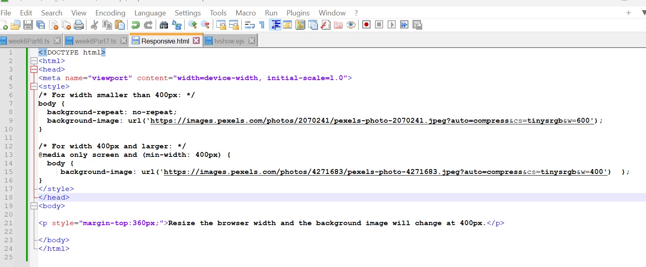
Example Swapping out Images once Media detects Smaller Size on Device
<!DOCTYPE html>
<html>
<head>
<meta name="viewport" content="width=device-width, initial-scale=1.0">
<style>
/* For width smaller than 400px: */
body {
background-repeat: no-repeat;
background-image: url(‘https://images.pexels.com/photos/2070241/pexels-photo-2070241.jpeg?auto=compress&cs=tinysrgb&w=600');
}
/* For width 400px and larger: */
@media only screen and (min-width: 400px) {
body {
background-image: url(‘https://images.pexels.com/photos/4271683/pexels-photo-4271683.jpeg?auto=compress&cs=tinysrgb&w=400’);
}
}
</style>
</head>
<body>
<p style="margin-top:360px;">Resize the browser width and the background image will change at 400px.</p>
</body>
</html>

Slide 43
Q&A

